Slide 1
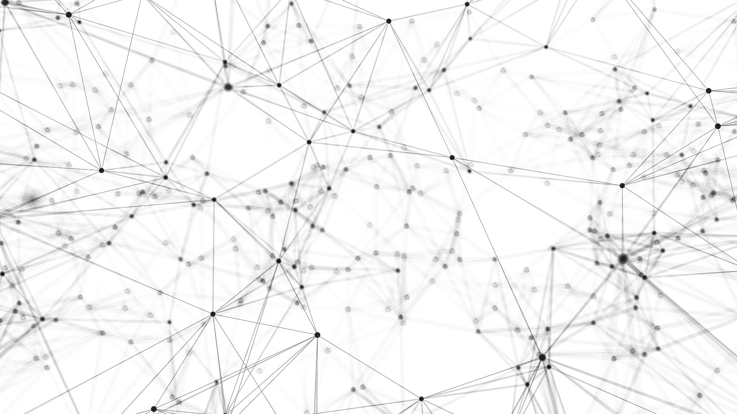

AI-generated & real face recognition using neural network
Can a neural network model distinguish the faces of real people from those generated by another neural network?
Arek Tarnawski | Final Bootcamp Project | Amsterdam '21

Slide 2


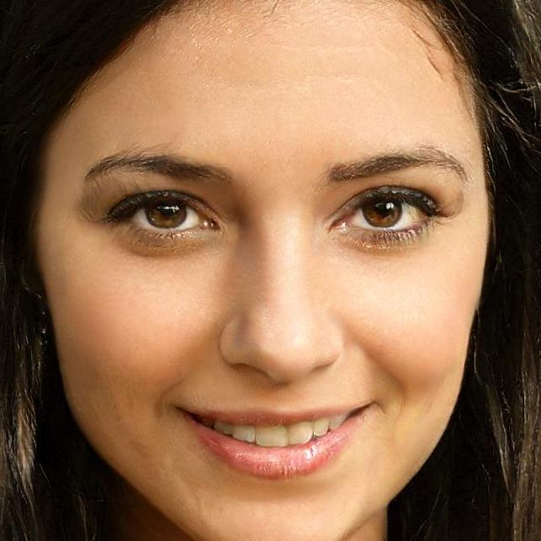



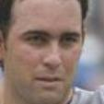



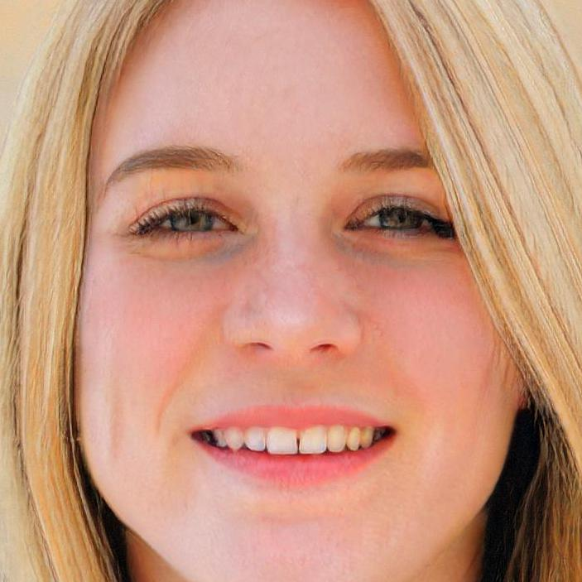

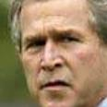



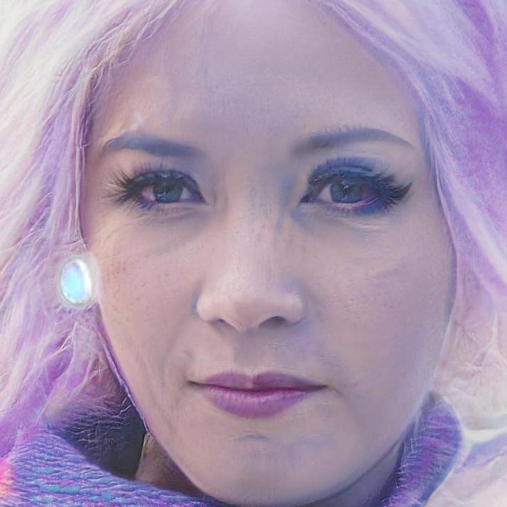
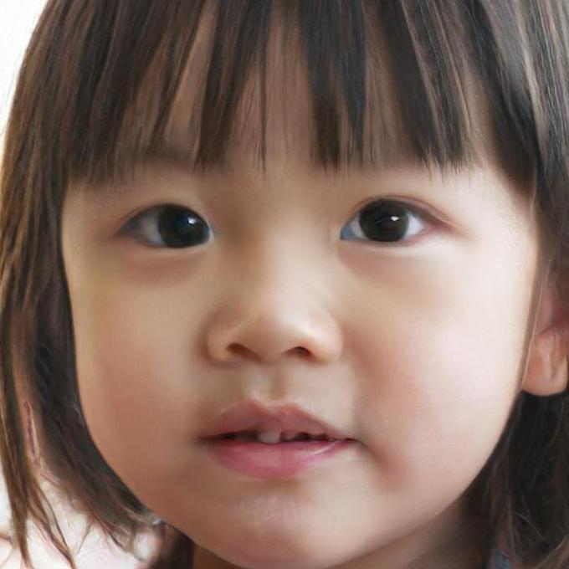






THE DATASET - What's in there?
10,000 AI-generated faces
These people do not exist
10,000 real faces
Real photographs of real people

Slide 3
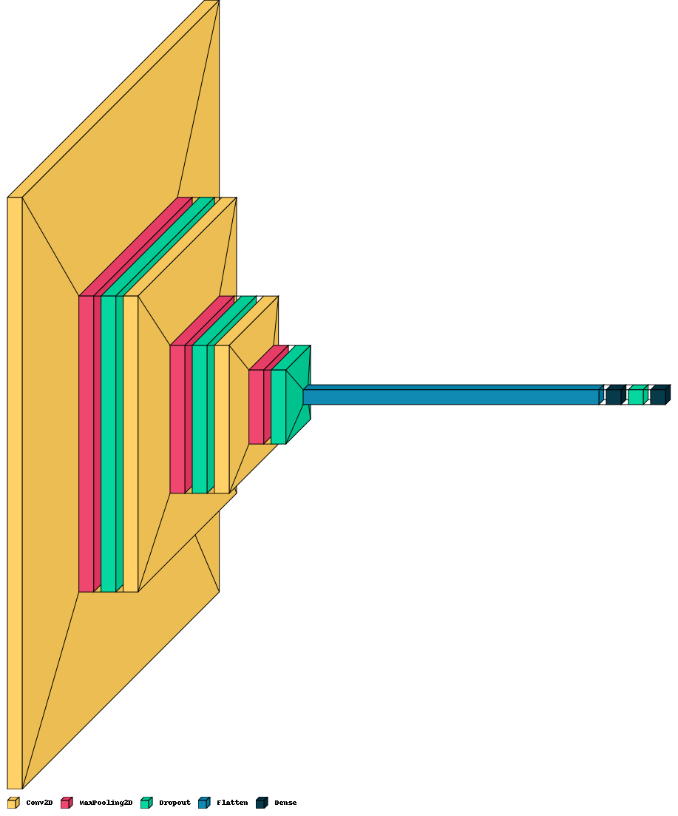
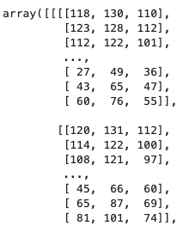
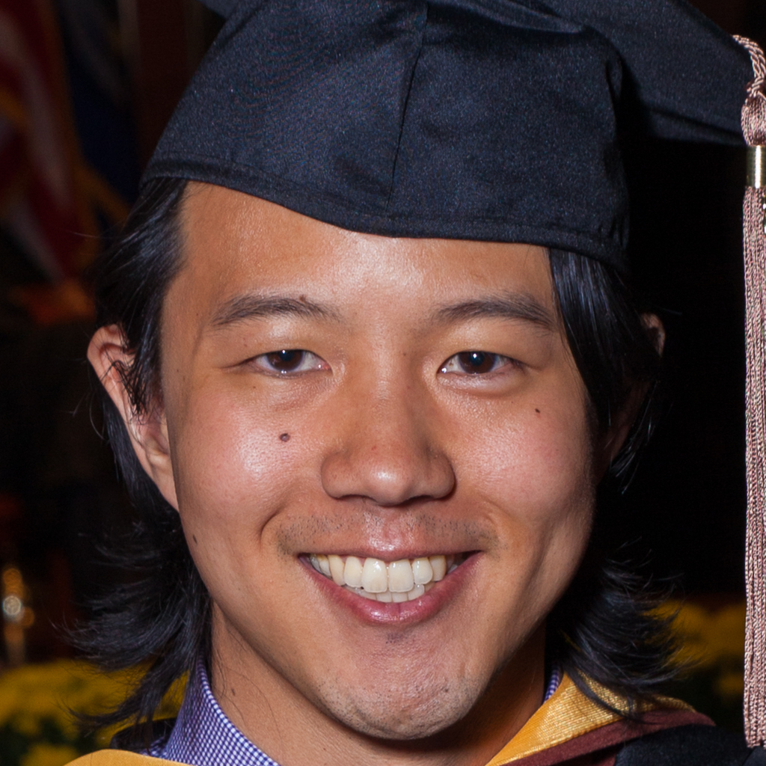





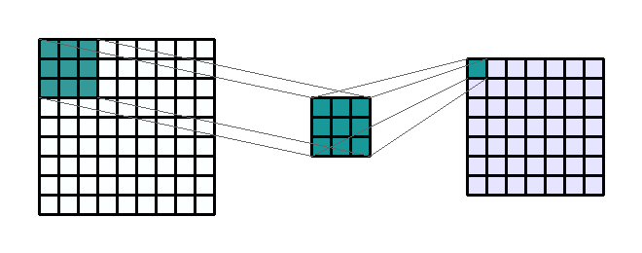
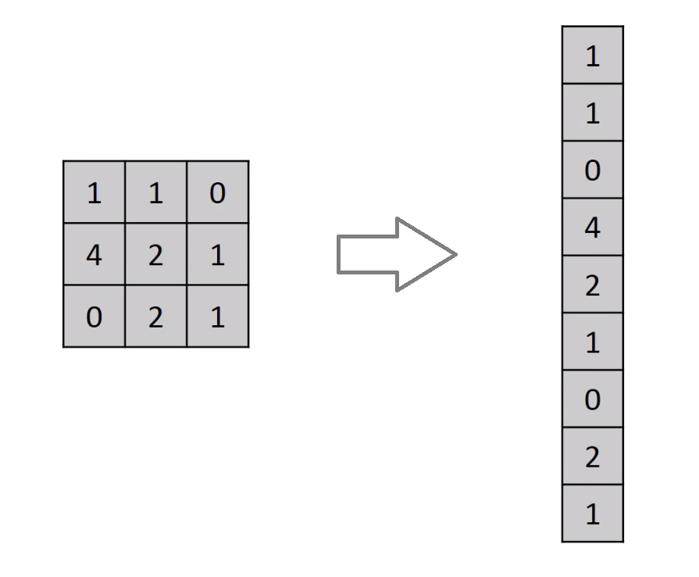
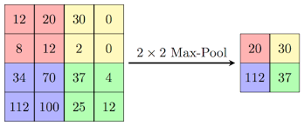
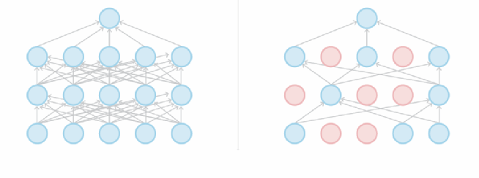
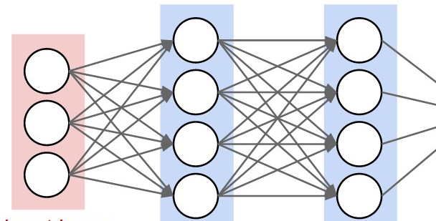
The Forward march SEQUENTIAL model
13 total layers:
3 Conv2D layers
3 Pooling layers
4 Dropout layers
1 Flatten layer
2 Dense layers
A total of 10M+ trainable parameters
97% accuracy on train/test
[0,1]
Output
1 – real
0 - fake
200 x 200 pixels
Image
Very similar to well-known VGG16 model proposed in 2014 @ Oxford Uni
200 x 200 x 3
NumPy Array
Notes:
Conv2D – Scanning the image from left to right, top to bottom using a 3x3 window and producing a single pixel output (filtered image). Patterns/edges search
MaxPooling – downsampling to prevent overfitting – reduces the number of pixels from convolutional layer
Dropout – drops random neurons to prevent over-fitting and individual neurons becoming too powerful
Flatten – reshapes the multi-dimensional input into a 1D array
Dense - it is most common and frequently used layer. Dense layer does the below operation on the input and return the output:
output = activation_function(dotproduct(input, weights) + bias)

Slide 4
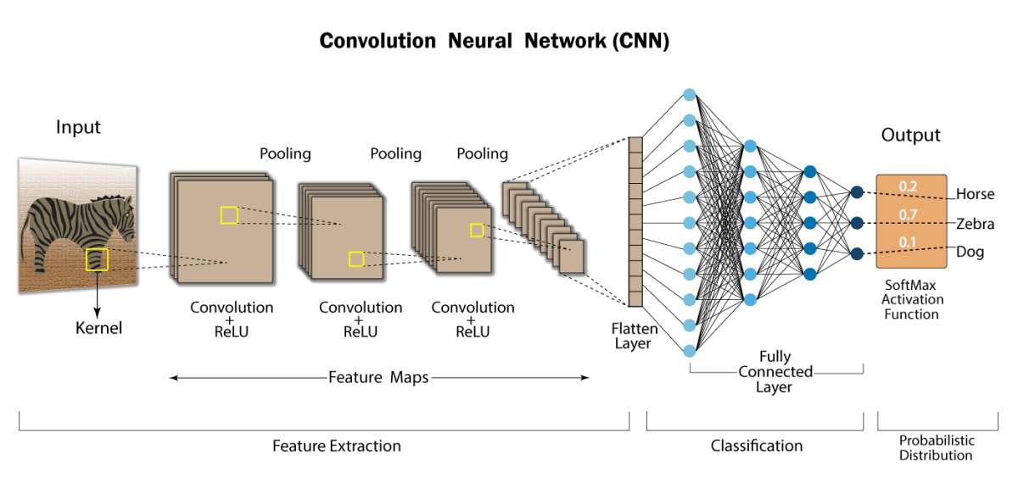
How it works

Slide 5

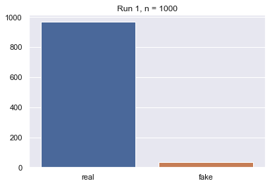
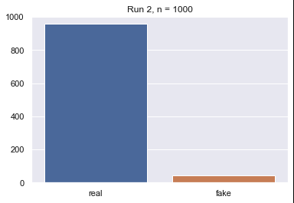

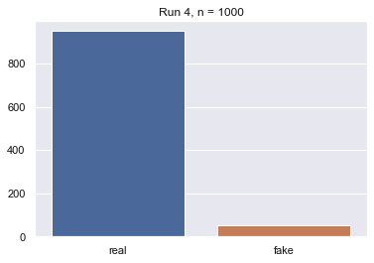

How good is The model?
Real faces recognition accuracy using the train/test set
96,8%
95,8%
95,7%
95,0%
95,3%
Average: 95,7%

Slide 6

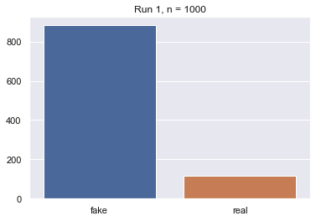
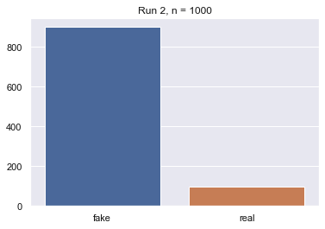

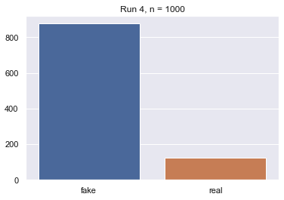
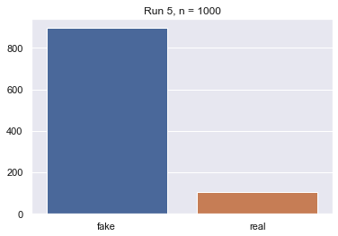
HOW good is the model?
Fake faces recognition accuracy using the train/test set
88,3%
90,1%
88,8%
87,7%
89,6%
Average: 88,9%

Slide 7






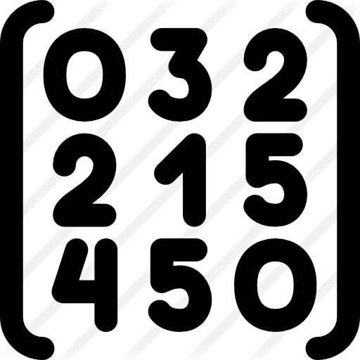




The App PIPELINE
Fake: load from API
Real
Ironhack: load from drive
Fake
Load model
Load image
Resize image
Display image
Convert to array
Predict if real/fake
Display prediction
Visualize in GUI

Slide 8
DEMO – Streamlit App

Slide 9
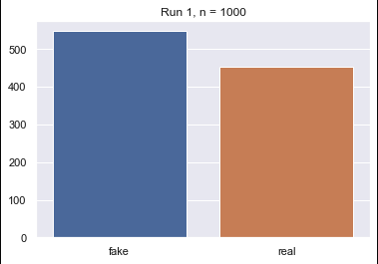
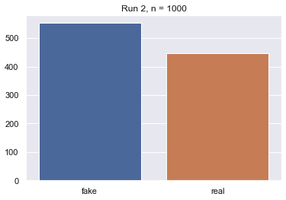
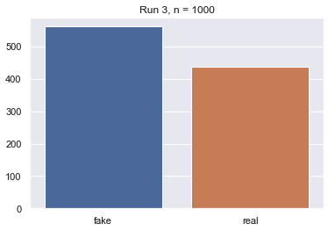
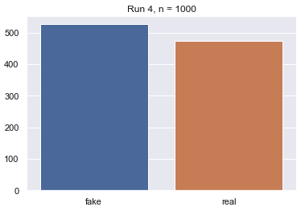
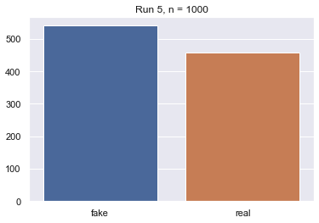

USING The model
Fake faces recognition accuracy using the unseen data (outside train/test dataset)
The data comes from an API call to fakeface.rest, NVIDIA AI-generated faces service
54,8%
55,3%
56,2%
52,7%
54,1%
Average: 54,6%

Slide 10
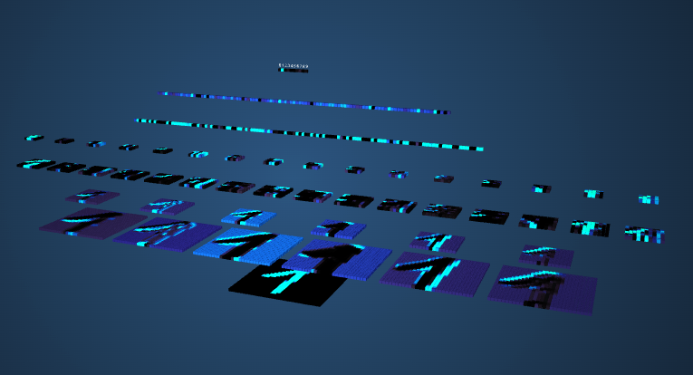
Bonus - VISUALIZATION
Link to the tool

